Slide 1
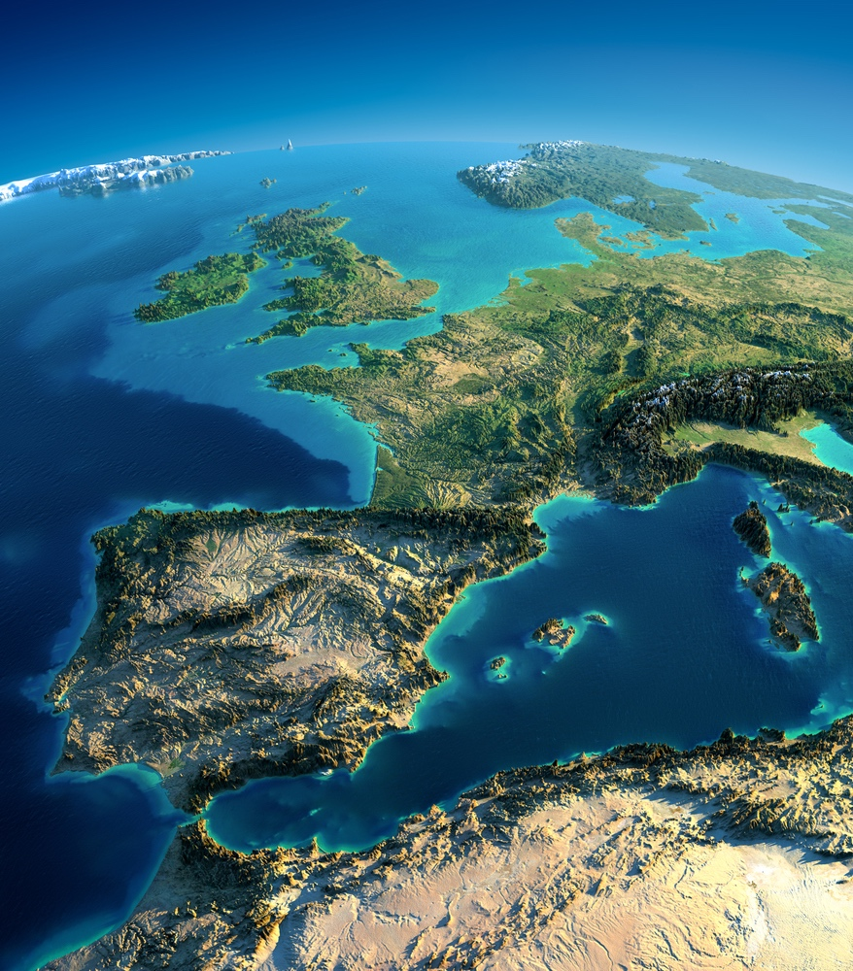
Let’s talk about Europe for a change...

Slide 2
... And obviously about frosts
Are false springs increasing??
Decreasing??
Is absolutely nothing changing with them?

Slide 4
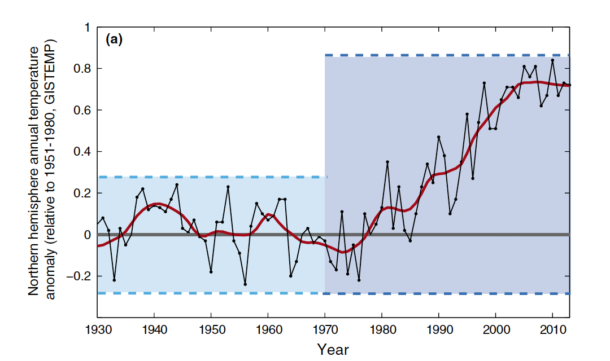

Slide 5
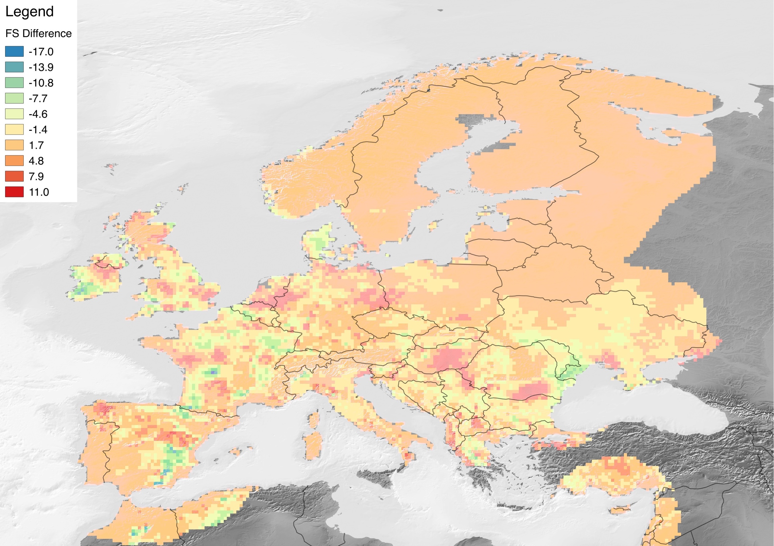
Difference in number of spring freezes after temperature trends increased in the 1980s
Blue/Green: More after the 80s
Red: less after the 80s

Slide 6
Depends on location of study apparently...
What are scientists looking at?
Mean Spring Temperature
Elevation gradients
Latitudinal gradients
So then what are we missing???
Distance from the coast!!
North Atlantic Oscillation Index
EVERYTHING COMBINED!
Notes:
Affects the location and intensity of the North Atlantic jet stream, which results in large-scale shifts in temperature and precipitation. Positive: above-normal temps and precipitation in eastern and northern Europe and below-normal temps in Greenland and sometimes southern Europe and below-normal precip in central/southern Europe

Slide 7
